Slide 1
Group Project
Level 4/5 Group 19
Ogheneochuko Ideh
Thomas Barrett
Samuel Ormondroyd
Notes:
Welcome to the pitch presentation of group 19.
I am : state names

Slide 2
Game Title CBA
Presented to:
Stakeholders & Ubisoft Bucharest
01/02/2017

Slide 3
Market overview
Projected demographics | Unisex audience. Primarily targeted from ages 7 – 14 Apriopiate for children (and adults) ages seven and up.
Genre: | The triple A Action, Arcade, Adversary
Platform Specs: | Windows Unity Excecutable
Notes:
Before we begin, here is a breif run through of iur market overview/game specs.
Projected demographic: We are targeting our game off the succes of the games such as angry birds. The game will be geared towrads uchildren of both genders from 7 and up, although the game is also open to a universal audience.
This is because ethe game will induct simple to learn mechanics that will still pose as a challenge to master.
The genre of our game is something we dubbed; Tripple A.
This is:Action,Arcade amnd Adversary.
The premise and overall goal is to beat yopur oppenents score.
Platform Soecs:
The game will be playable on PCs as a Windows executable file

Slide 4
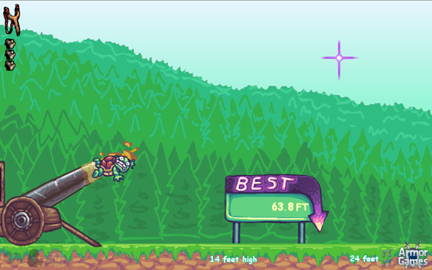
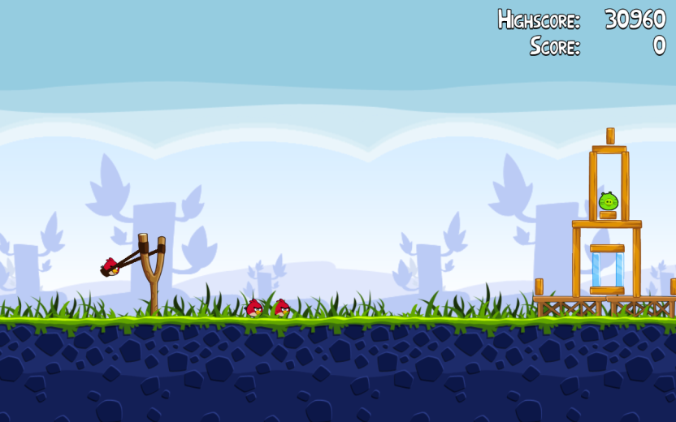
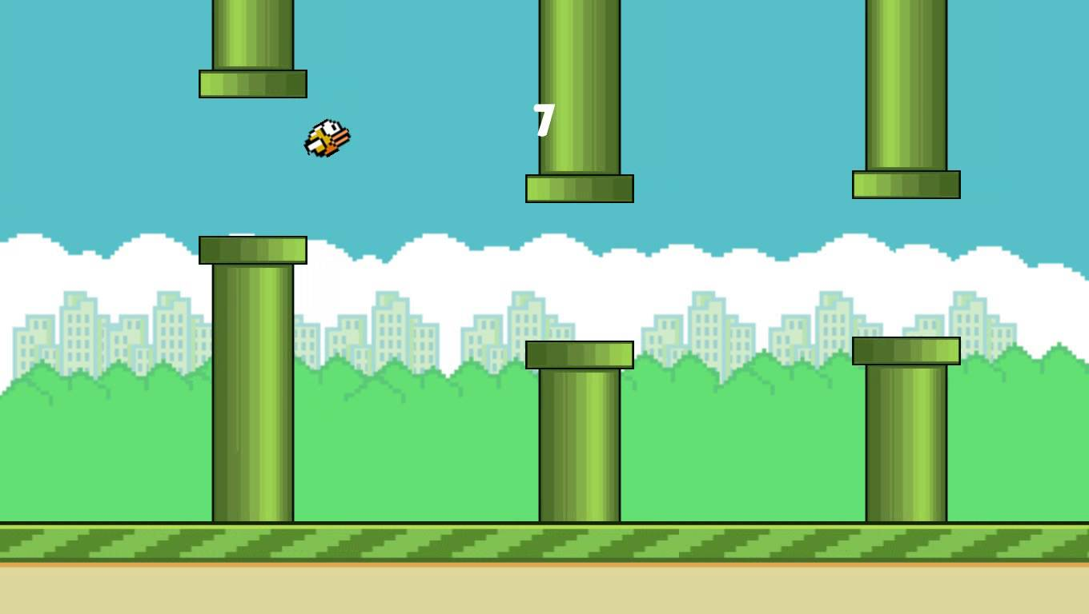
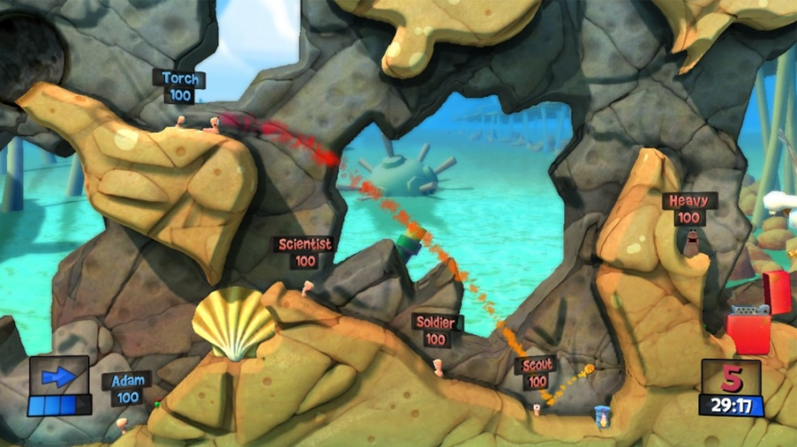
Inspirations
Toss the turtle
Angry Birds
Flappy Bird
Worms
Notes:
Durring our research we were fund of games which featured trajectory and moementum as central mechanics.
These mechanaics take center stage in games such as ......... Etc.
We aimed to incooporate these mechamnic as they would allow players to take stragigly thought out playthroughs, as they will be calculating where the projectile will land and how far it could travel.

Slide 5
Logline
TBC
Notes:
The logline for our game goes as follows:
Mans best friend must now brave this new adventure as he struggles to avoid vicious feline ghouls whilst collecting the remnants of his memories.

Slide 6
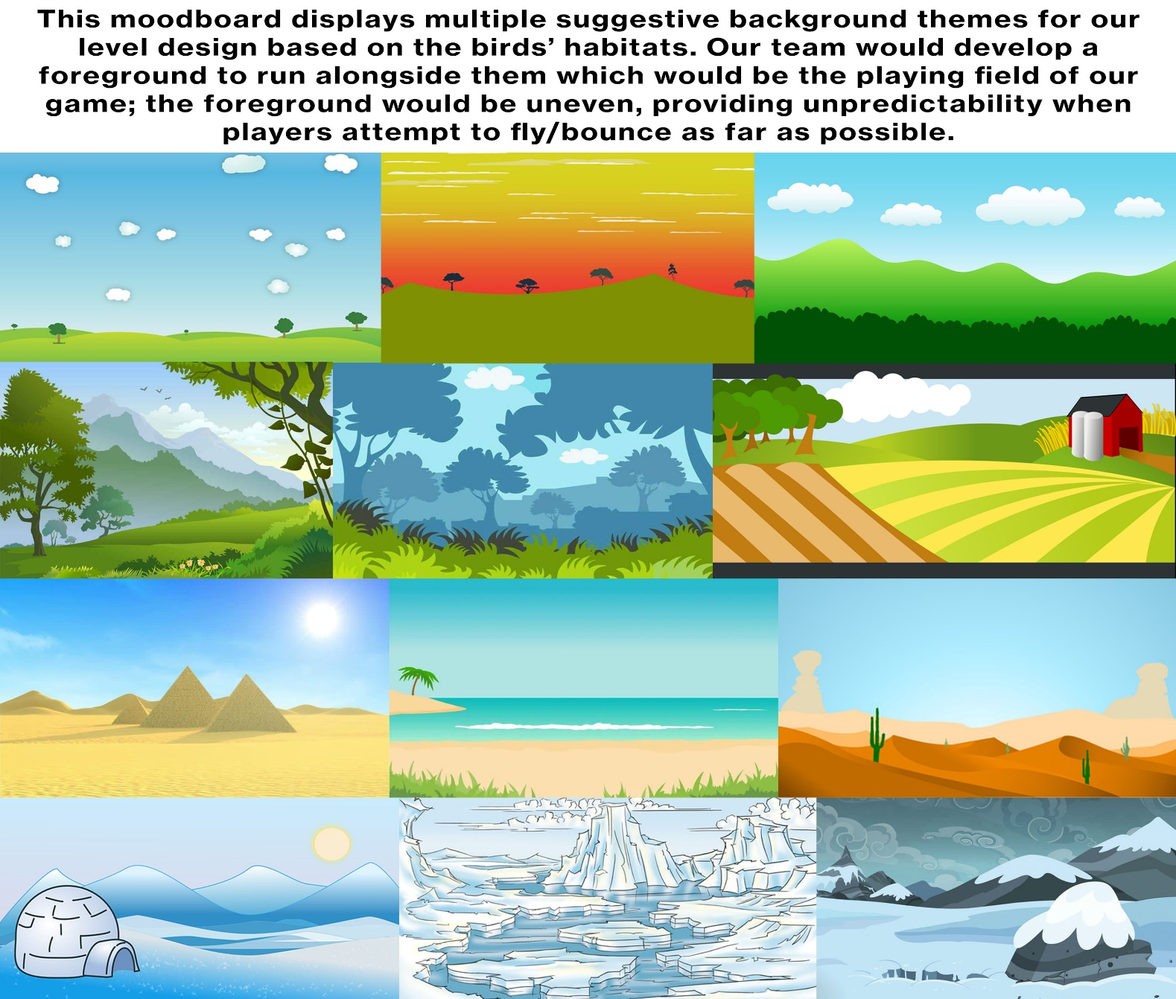
Moodboards and concept

Slide 7
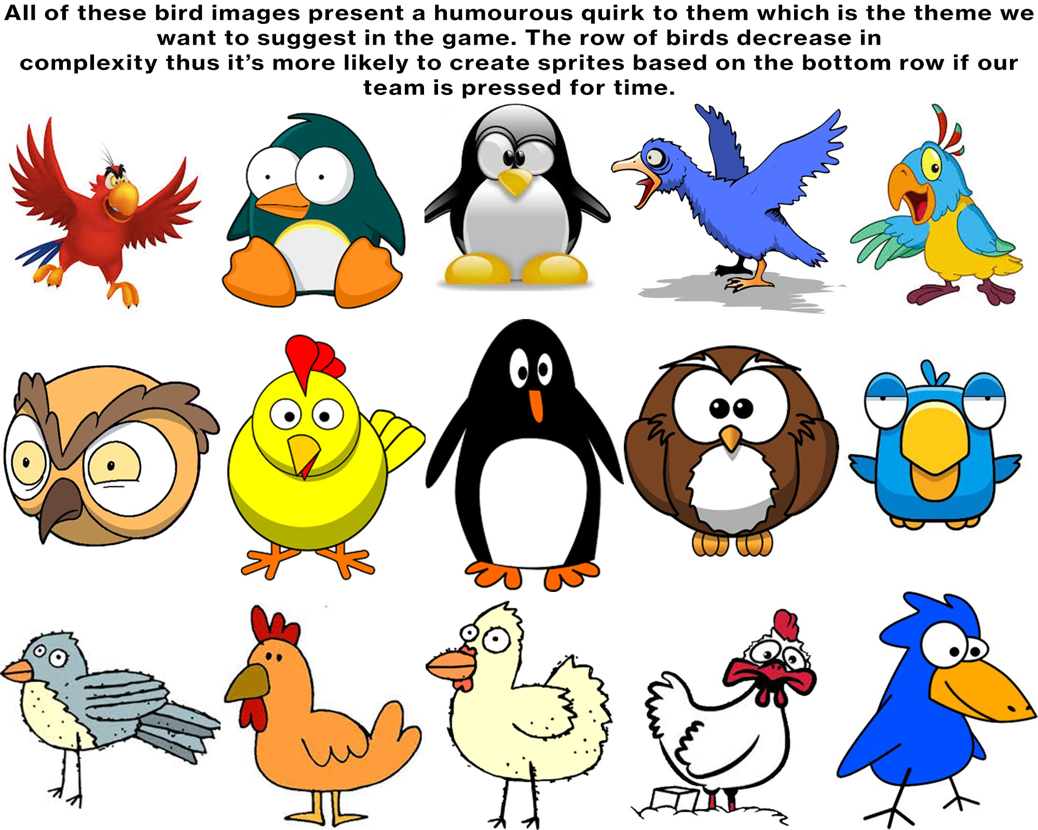
Moodboards and concept

Slide 8
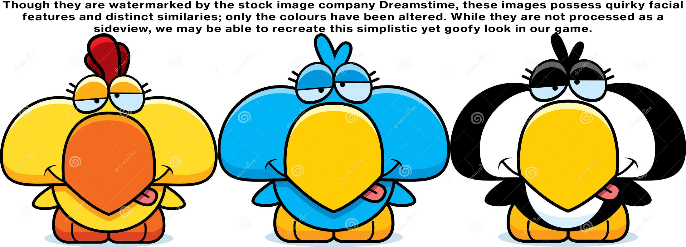
Moodboards and concept

Slide 9
Game play and apperence
Prototype Showcase
Action, phyics, adversray, turn based game.
Main gameplay will take place on landscape 2D overworld.
Using the catapult, players can ajust tjhe trajectory and momentum of the flightless birds in order to travel the furthest distance.

Slide 10
Game play and apperence
Prototype Showcase
Players can use the stamina to either thrust bird upwards or forwards.
Thrusting forwards allows the bird to travel highter, thereby increasing the momentum of eventual impact.
Players can trust be repeatedly pressing the allocated keys, which inturn causes a twich mechanic.
The larger the momentum upon impact, the further the bird will recoil.

Slide 11
Game play and apperence
Prototype Showcase
Thrusting forward will allows the bird to travel further prior to impact.
Players stamina is restricted to a stamina bar seen in the UI.
The more a player thrusts the less stamina they will have in turn.
Budgeting stamina will in turn cause players to be strategic when planing to use their thrust function. Allowing for an overall strategic play.

Slide 12
Game play and apperence
Prototype Showcase
Players may also use the thrust function to avoid geometry based obstacles that may affect the distance travelled.
Once the players bird comes to a halt the distance travelled is calculated and stored leading into the next players turn.
The player who travels the furthest wins the round.
The game consist of three rounds, best two out three wins the game.

Slide 13
Prototype Showcase

Slide 14
Concept art

Slide 15
Player roles and actions
Main objective: Travel furthest whilst budgeting stamina.
Secondary objective: Avoid obstacles which may draw travelled distance to a halt.
Players thrust using a twich mechanic.
Working with trajectory, momentum and budgeting stamina allows for a strategic play.

Slide 16
Development specifications
Unity 2D
MonoDevelop / Visual studios
Photoshop

Slide 17
Achieving Fun
Hard Fun
People fun
Serious fun
Notes:
Hard fun : Goals Obstacles and Stratergy
People fun: Compete, this creates an amusment emotion
Serious fun:
Repition, rythm this creates excitment

Slide 18
Scope and End Goals
We are here
End goals
Strech goals
End goals
Functional two player build.
Preceduarly generated plain.
Sound effects
Strech goals
Animation.
Parallax scrolling background.

Slide 19
Emails sent

